Slide 1
Project Management Workshop
Jordania leon-Jordan

Slide 2
A project is…
A temporary one-time coordinated undertaking that:
has a goal/outcome;
has interrelated and dependent activities and tasks;
is finite in duration with starting and ending points;
uses resources: human, capital, systems;
produces unique product(s), service(s) or information;
operates under time, quality, cost, and scope targets / constraints

Slide 3
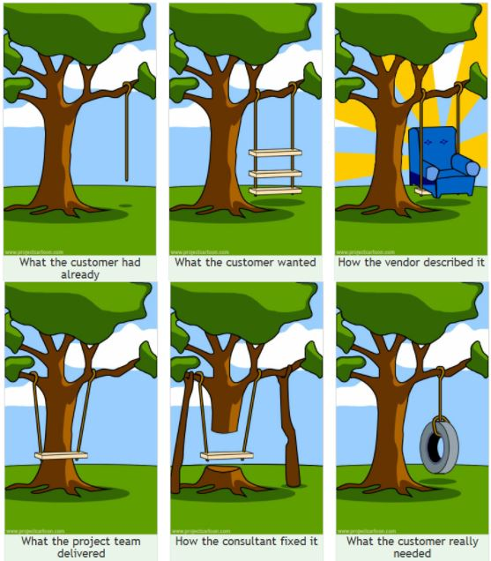
Project Management Pitfalls
From the University of London Computer Centre Newsletter No.53, March 1973

Slide 4



In simple terms…
Everyone wants a project to be…
Good
Fast
Cheap

Slide 5
The Magic is Balancing 4 key Elements
Quality
Cost
Time
Scope
Quality
Cost
Scope
Time

Slide 6
In summary
Project Management is..
no more and no less than managing everything that needs to be done to finally hand over a specified deliverable to a customer in a way that satisfies the customers and key stakeholders.

Slide 7
Project Management Framework
Leading and Managing
(Communications)
Conceptualization
(pre-project)
Initiation
Planning /
Scheduling
Executing /
Controlling
Closure
Project Phases

Slide 8
Creating Questions
Who?
What?
Where?
When?
Why?
How?

Slide 9
Project Management Framework
Leading and Managing
(Communications)
Conceptualization
(pre-project)
Initiation
Planning /
Scheduling
Executing /
Controlling
Closure
Project Phases

Slide 10
Steps in Initiating the Project (I)
Understand the Project
Review any relevant documents and gather information
Identify the Customers / Stakeholders
Develop a Business Case/Pre-Charter
Establish the Project Team
Define roles and responsibilities
Identify / select team members

Slide 11
Steps in Initiating the Project (II)
Set Up the Project Management Processes
Change Management, Risk Management, Issue Resolution, etc.
Draft the Project Charter
Define the project strategy and approach
Schedule and Conduct a Kick-off Meeting
Finalize the Project Charter
Establish the Communication Plan
Who, what, when, and how of communicating

Slide 12
Project Charter: Overview
What is it?
Agreement between parties explaining how project will be managed and structured
Collection of information the team needs to perform its day-to-day activities; defines the basic approach or process to be taken
Documents processes that have been defined---a record of the work completed
A living, breathing document

Slide 13
Project Charter
Menu of Charter Elements
Project title
Project description
Business case
Stakeholders
Scope/Not-in-Scope
Deliverables
Implementation plan
Team members, roles
Approvals/sign-off
Budget/Resources
Project risks
Communication plan
Issue resolution plan
Change management plan
Process flow charts
Work Breakdown Structure

Slide 14
Approval/Signoff
Approval / Signoff Process
Executive sponsor should provide approval and signoff on the charter
Every project has deliverables that may need to be approved before moving ahead

Slide 15
Communication is Critical
Essential function that can dramatically affect the outcome of a project
Planning up front is worth its weight in gold
Helps set priorities
Ensures those who need information get it
Avoids surprises
Plan should define who is responsible for what, where, when and how

Slide 16
Communication Plan Checklist
Define the scope, deliverables and responsibilities
Identify the audience
Establish the communication goals
Determine the strategy for messages
Develop tools and opportunities
Establish milestones
Outline communication timeline and activities

Slide 17
Communication Plan Elements
Timing / calendar
Message(s)
Audience(s)
Vehicle(s)
Responsibility

Slide 18
Project Management Framework
Leading and Managing
(Communications)
Conceptualization
(pre-project)
Initiation
Planning /
Scheduling
Executing /
Controlling
Closure
Project Phases

Slide 19
Planning? Scheduling? Estimating?
What is Planning?
Planning is the systematic identification and arrangement of tasks or steps to accomplish an objective
What is Scheduling?
Scheduling is the process to define when each step will be done, how long will it take, and who will do it.
What is Estimating?
Estimating is the process to determining how long each of the steps in the plan will take, how much each step is expected to cost, and when the steps will be completed.

Slide 20
A Plan…
Demonstrates understanding (or not)
Is a roadmap to follow
Is a baseline to compare progress
Is a communication tool
Is a commitment to deliver
Provides information for the future projects

Slide 21
How Do we Plan?
Start with the project objectives
What does “DONE” look like?
Define the tasks that need to get done.
Determine the sequence/relationships of those tasks.
Estimate the effort and duration of each task.
Assign responsibility for each of the tasks.
Document the schedule.
Affirm commitment from everyone
Set the project base-line.
Publish the plan.
Maintain the plan.

Slide 22
Defining the Tasks
Work Breakdown Structure (WBS)
Plan the tasks
Display levels of detail
Communicate
Defines the effort
Used to build the schedule
Input to WBS is the requirements defined in the project charter

Slide 23
Example: Landscaping Project Tasks
Complete the landscape design
Install new fence
Remove trees and shrubs
Install sprinkler system
Remove old walkway
Install new walkways
Plant new shrubs and trees
Install new lighting
Plant new lawn
Call Digger’s Hotline

Slide 24
WBS – Grouping Tasks
Complete the landscape design
Demolition
Call Digger’s Hotline
Remove trees & shrubs
Remove old walkway
Remove lawn as needed
Site Preparation
Regrade soil
Sprinkler piping
Lighting rough-in
Finish Work
Install fence
Install walkway
Plant shrubs
Install sprinklers
Install lighting

Slide 25
Before Creating the Schedule
Questions while scheduling.
Which tasks go first? And later?
Which tasks can happen at the same time?
Is there any “empty/slack” time?
What are the relationships between tasks?
What are the inputs to each task?
What are the outputs to each task? (deliverables)
Who will do each task?

Slide 26
Example of Task Relationships
Landscape Project
Complete Design
Begin demolition
Call Digger’s Hotline
Remove trees and shrubs
Remove Walkway
Begin Site Prep
Regrade Soil
Remove Sod
Rough-in lighting
Finish lighting
Rough-in sprinklers
Finish sprinklers
Prep fence line
Install fencing
Prep Walkway
Install pavers

Slide 27
The Planning Process
Start with a list of tasks
Determine logical dependencies among tasks
Identify skills needed to complete tasks
Assign resources to each task
Develop timeline for each task
Go back to point 1 until everything is complete

Slide 28
The Scheduling Process
Start with a list of tasks
Organized tasks in “logical” order
Analyze the skills needed to do the work
Identify appropriate resources
Assign each task to people
Find the relationships between the tasks
Level the resources, if necessary

Slide 29
Planning, Scheduling, & Estimating
Enter the tasks
Create the WBS
Identify predecessors/relationships
Enter the durations for each task
Assign resources for each task

Slide 30
Project Management Framework
Leading and Managing
(Communications)
Conceptualization
(pre-project)
Initiation
Planning /
Scheduling
Executing /
Controlling
Closure
Project Phases

Slide 31
Key Topics in Executive/Controlling
Risk Management
Change Management
Status and Progress Reporting
Control Tools

Slide 32
What is Risk Management?
A systematic process of planning, identifying, assessing and handling project risks.

Slide 33
Risk Management
Risk Management Process
What’s a risk?
An issue that hasn’t occurred yet, but could impact the project (positively or negatively)
Why identify / mitigate risks?
Naming a risk helps you identify what could happen
Understanding a risk helps you determine mitigation strategies

Slide 34
Identifying Risks
Risk Management Process
Need to define
Different levels of risks (high/medium/low)
Probability/Impact/Severity of risks
How risks are tracked
Who is responsible for monitoring each risk
What’s the plan for each risk
How is it known that the “danger” is gone

Slide 35
Risk Assessment/ Mitigation Template
Initial Risk Assessment
Risk Description | Probability (High, Med. Low) | Impact (High, Med. Low) | When Risk May Occur | Mitigation Plan
Team not able to clearly articulate business needs | Low | High | During Initiating/Planning Phase | Use a structured process for needs identification
Unavailability of key stakeholders and process owners | Medium | High | Anytime | Build relationships Pre-schedule time with stakeholders Identify and establish multiple communication channels

Slide 36
Project Management Framework
Leading and Managing
(Communications)
Conceptualization
(pre-project)
Initiation
Planning /
Scheduling
Executing /
Controlling
Closure
Project Phases

Slide 37
Why Is Project Closure Is Important?
To assess the project
To discuss lessons learned and best practices
So team feels a sense of completion and resources can be released for other projects
To provide recognition
To tie up loose ends
To transition to next effort

Slide 38
Preparing for project closure
Establish and/or review transition plans to the operational owner and obtain approvals
Prepare signoffs for the key stakeholders
Complete administrative work
Gather project documents

Slide 39
Project closure steps
Gather project feedback (surveys, etc.)
Prepare project closeout report
Have a Closeout Meeting
Complete the project, obtain signoffs, and transition to the operational owner
Recognize and reward the team-celebrate!

